Slide 1




AT82.02
Data Modeling and Management
Unit 1-4: Entity Relationship (ER) Model
Chutiporn Anutariya (chuti at ait dot ac dot th)

Slide 2
Evolution of data models
least
1960
Hierarchical
Difficult to represent M:N relationships (Hierarchical only)
Physical level dependency
No ad hoc queries
Access path predefined (navigational access)
1969
Network
Semantics in Data Model
Provides ad hoc queries
Set-oriented access
Weak semantic content
1970
Relational
1976
Entity Relationship
Easy to understand
Incorporates more semantics
1976
1978
Semantic
More semantics in data model
Support for complex objects
Inheritance
Behavior
1985
1990
Object-Oriented
Extended Relational (Object/Relational)
most
Address Big Data problem
Less semantics in data model
Based on schema-less key-value data model
Best suited for large sparse data stores
2009
Big Data
NoSQL

Slide 3
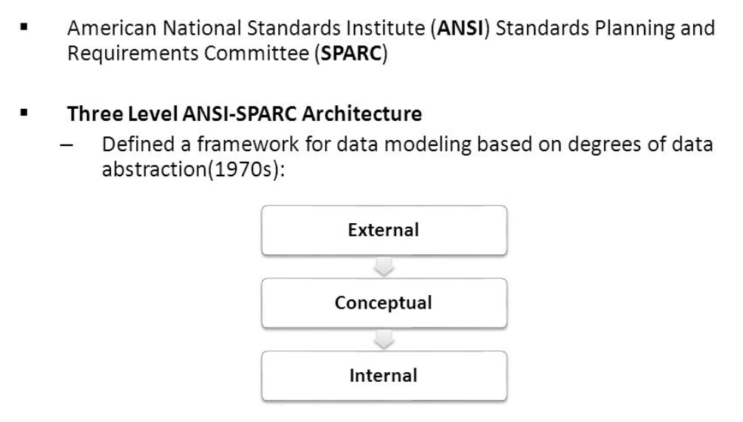
Degree of Data Abstraction

Slide 4
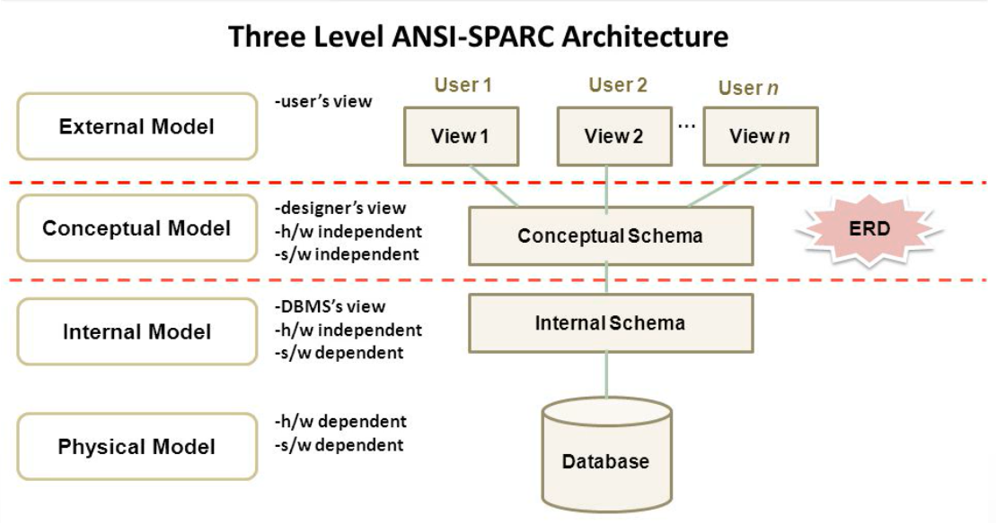
Data Abstraction

Slide 5
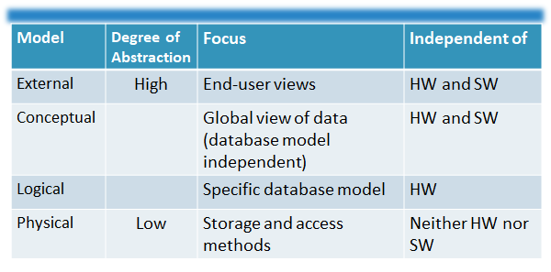
Data Abstraction Level

Slide 6
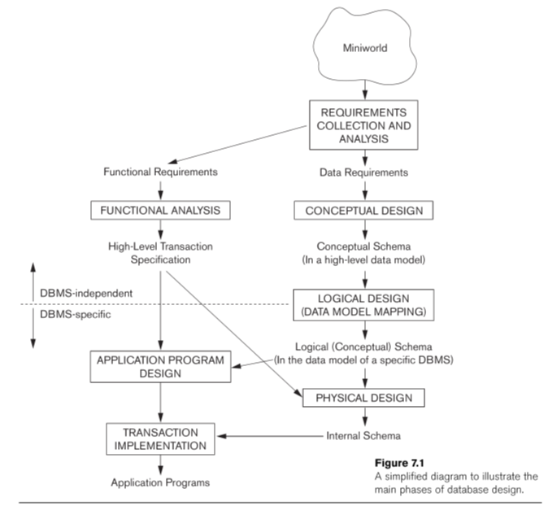
Main Phases of Database Design

Slide 7

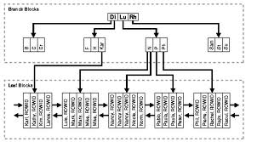

Using High-Level Conceptual Data Models for Database Design
[High-level] Conceptual Data Models
[Low-level] Physical Data Models
Representational Data Models

Slide 8
Requirements Collection and Analysis
Database designers interview prospective database users to understand and document data requirements
Result: data requirements
Functional requirements of the application

Slide 9
Conceptual Design
Conceptual schema
Description of data requirements
Includes detailed descriptions of the entity types, relationships, and constraints
Transformed from high-level data model into implementation data model

Slide 10
Logical Design or Data Model Mapping
Result is a database schema in implementation data model of DBMS

Slide 11
Physical Design
Internal storage structures, file organizations, indexes, access paths, and physical design parameters for the database files specified

Slide 12
Entity-Relationship Model

Slide 13
A Sample Database Application
COMPANY
Employees, departments, and projects
Company is organized into departments
Department controls a number of projects
Employee: store each employee’s name, Social Security number, address, salary, sex (gender), and birth date
Keep track of the dependents of each employee

Slide 14
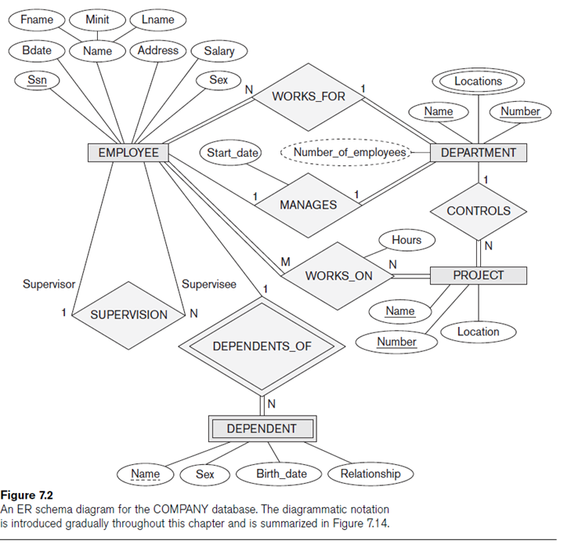
Company Database

Slide 15
ER Model
ER model describes data as:
Entities
Relationships
Attributes

Slide 16
Entities
An entity is a representation of a class of object.
It can be a person, place, thing, etc. Entities usually have attributes that describe them.

Slide 17
Attributes
Attribute:
Types of attributes:
An attribute is a property that describes a particular entity.
The attribute(s) that uniquely distinguishes an instance of the entity is the identifier.
Composite versus simple (atomic) attributes
Single-valued versus multivalued attributes
Stored versus derived attributes
NULL values
Complex attributes

Slide 18
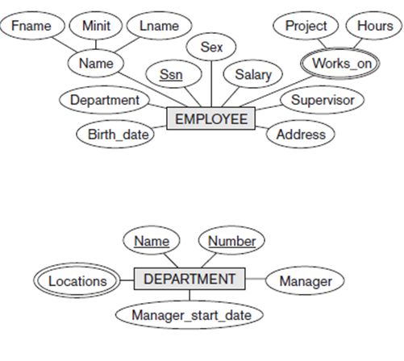
Composite & Multivalued Attributes

Slide 19
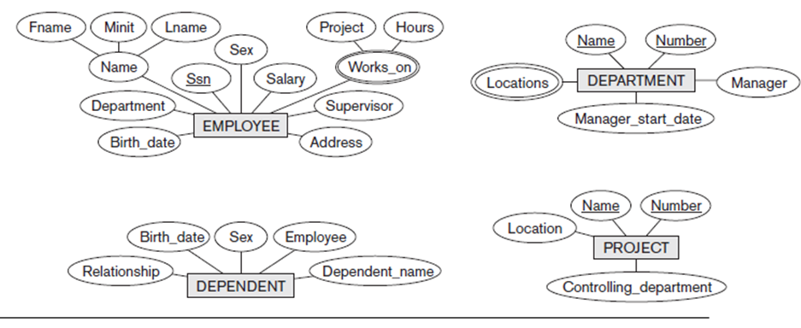
Initial Conceptual Design COMPANY Database

Slide 20
Relationships
When an attribute of one entity type refers to another entity type
Represent references as relationships not attributes
Relationships illustrate the association between two entities.
Usually, each relationship has a name, expressed as a verb. This describes what kind of relationship connects the objects.

Slide 21
Role Names and Recursive Relationships
Role names and recursive relationships
Role name signifies role that a participating entity plays in each relationship instance
Recursive relationships
Same entity type participates more than once in a relationship type in different roles
Must specify role name

Slide 22
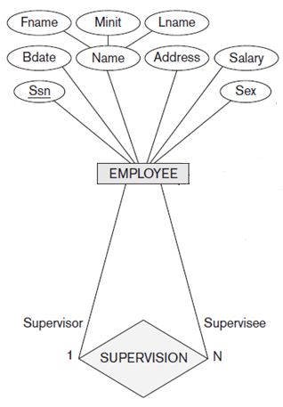
Example: Recursive Relationship & Role

Slide 23
Cardinality/Multiplicity
Multiplicity refers to the maximum number of times that an instance of one entity can be associated with instances in the related entity. It can be one or many.
One to one (1:1)
One to many (1:N)
Many to one (N:1)
Many to many (M:N)

Slide 24

Cardinality/Multiplicity
The minimum number of times one instance can be related to others. It can be zero or one, and accordingly describes the relationship as optional or mandatory.

Slide 25
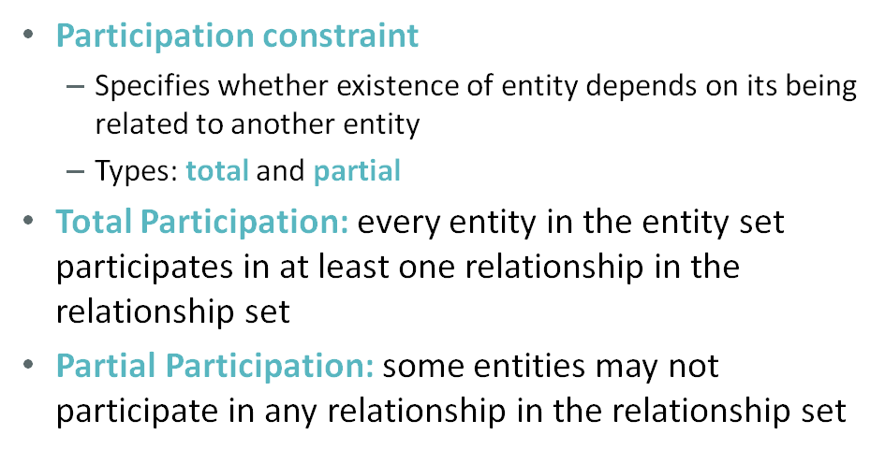
Mandatory vs Optional

Slide 26
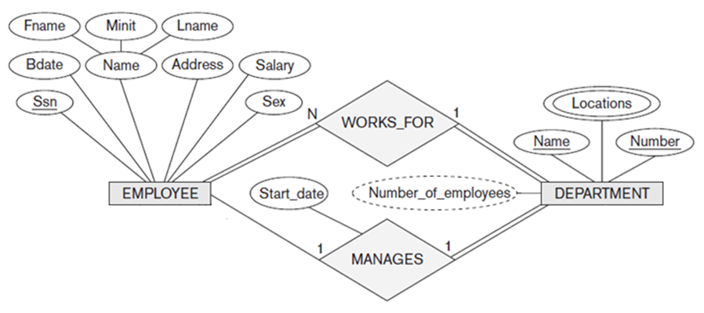
Ex: Cardinality & Participation Constraints

Slide 27
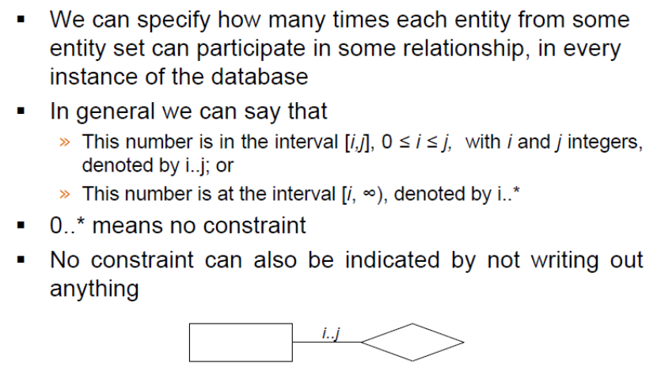
Alternate Notation

Slide 28
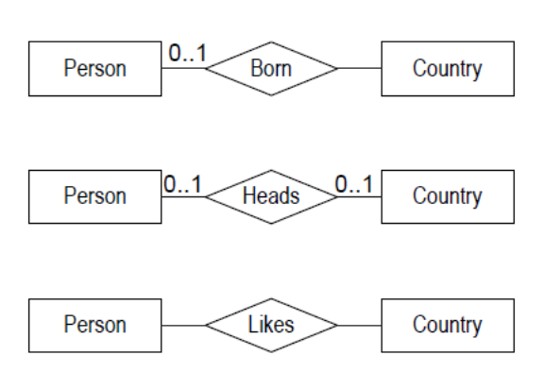
Ex: Alternate Notation

Slide 29
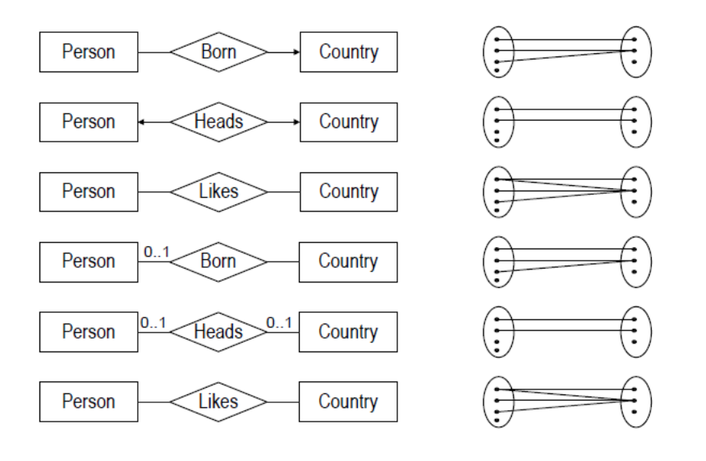
Ex: Alternate Notation

Slide 30
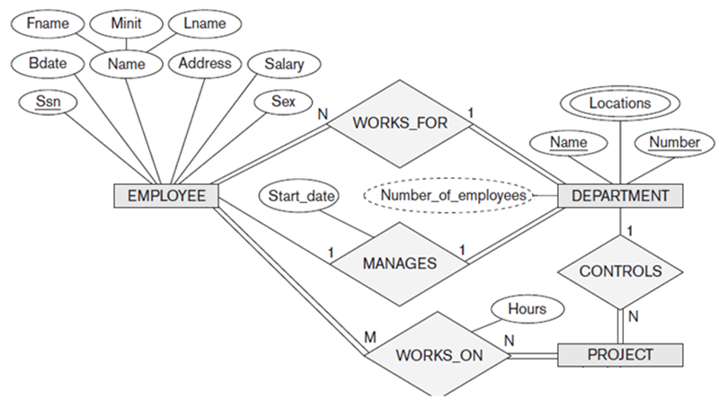
Attributes of Relationship
Relationship can also have attributes

Slide 31
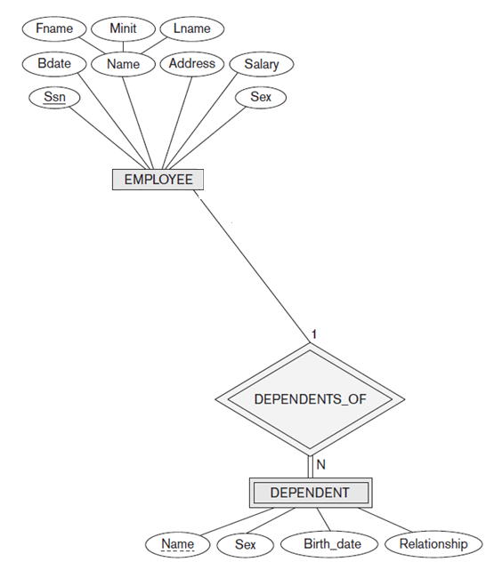
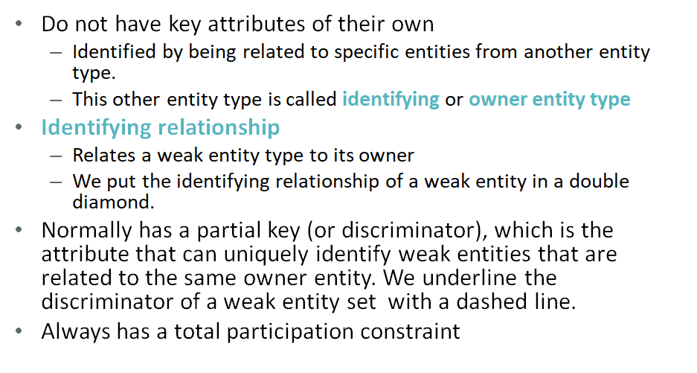
Weak Entity

Slide 32
Refining the ER Design for the COMPANY Database
Change attributes that represent relationships into relationship types
Determine cardinality ratio and participation constraint of each relationship type

Slide 34
Relationship Types of Degree
Higher than Two
Degree of a relationship type
Number of participating entity types
Binary
Relationship type of degree two
Ternary
Relationship type of degree three

Slide 35
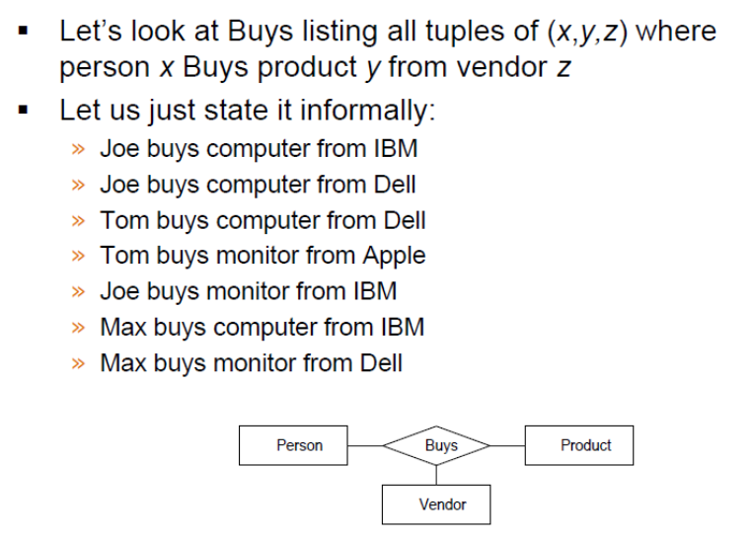
Ex: Ternary Relationship

Slide 36
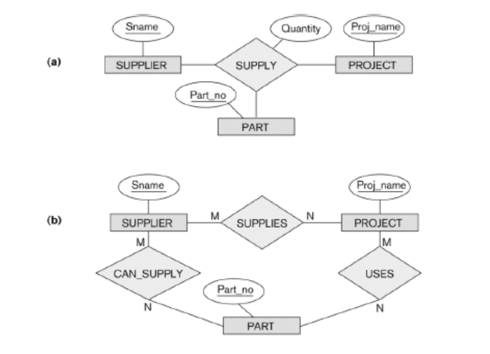
Ex: Ternary Relationships

Slide 37
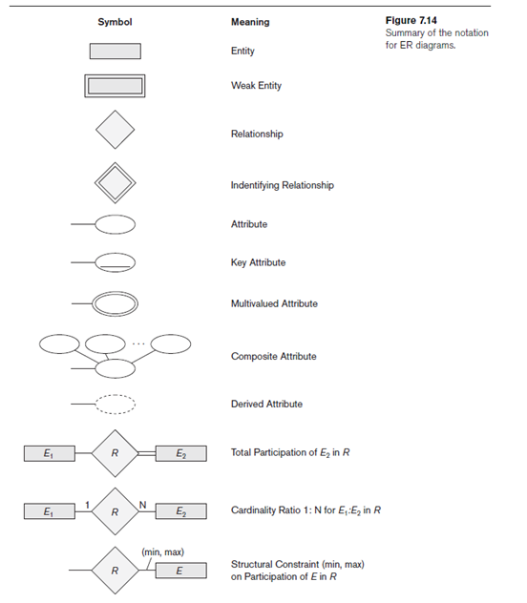
Model Notation Summary

Slide 38
ER Modeling Practices

Slide 39
Practice Time: Motor Vehicle Insurance Policy Management
An insurance company writes policies for drivers. One policy can cover many drivers and also many vehicles, but a vehicle can be related to only one policy. Drivers can share one or more vehicles (e.g. a husband and wife own one vehicle and they both drive the same vehicle or a family can have multiple vehicles).
The company gets a master list of violations from the Department of Motor Vehicles. These violations are then input into the system and used to determine the price of the policy. A driver may commit more than one violation. One or more drivers can commit the same violation. The system should keep a track of all customers - active (with insurance) and inactive (held in an archive – for cancelled customers). All customers should be able to get a quote, insurance or cancel the insurance.

Slide 40
Practice Time: Fix It
The repair company “FixIT” has hired you to design a database system to keep track of its operations. FixIT gives services to repair any IT computing devices such as computer desktops, laptops and smartphones of any models and makes. The system should keep track of the repair jobs, the items (or parts) used for each repair job, the labor costs for each repair job, the repairmen performing each repair job, and the total cost of each repair job.
When a customer bring a device in to be repaired, he/she describes the device’s problem, makes a deposit on the repair job, and is given an estimated date to return and uplift their devices. Repairmen then perform repairs based on the repair job, and detail the labor costs and the items (parts) used for each repair job.
Each customer may check the status and details of his/her repair job from the online system by entering the job ID or customer name. When a customer returns, he/she pays the total cost of the repair job less the deposit, collects a receipt for the payment, and uplifts the repaired device.

Slide 41
ER Diagrams, Naming Conventions, and Design Issues

Slide 42
Proper Naming of Schema Constructs
Choose names that convey meanings attached to different constructs in schema
Nouns give rise to entity type names
Verbs indicate names of relationship types
Choose binary relationship names to make ER diagram readable from left to right and from top to bottom

Slide 43
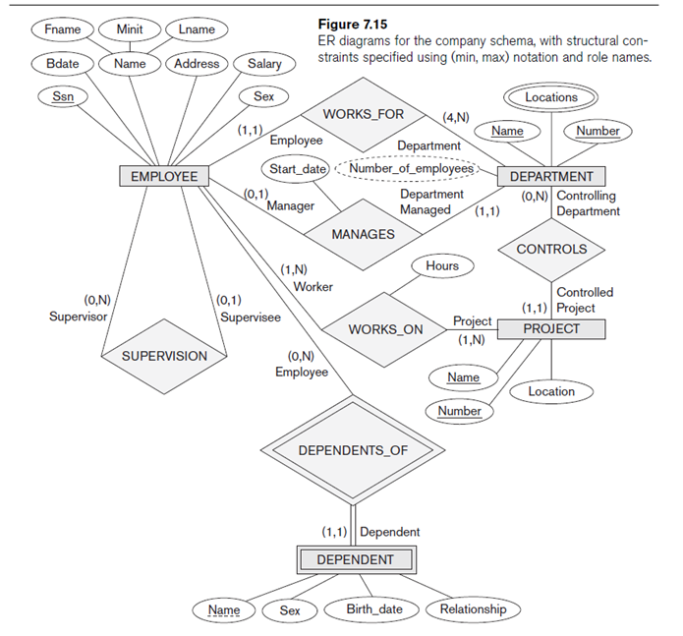
Alternative Notations for ER Diagrams
Specify structural constraints on relationships
Replaces cardinality ratio (1:1, 1:N, M:N) and single/double line notation for participation constraints
Associate a pair of integer numbers (min, max) with each participation of an entity type E in a relationship type R, where 0 ≤ min ≤ max and max ≥ 1

Slide 44
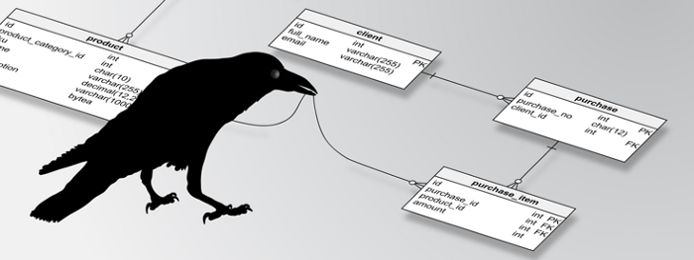
Entity-Relationship Model
Using Crow’s Foot Notation
Crow’s Foot Notation

Slide 45
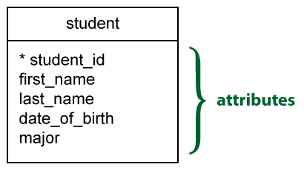
Entities and Attributes
An entity is a representation of a class of object. It can be a person, place, thing, etc. Entities usually have attributes that describe them.
An attribute is a property that describes a particular entity.
The attribute(s) that uniquely distinguishes an instance of the entity is the identifier.

Slide 46
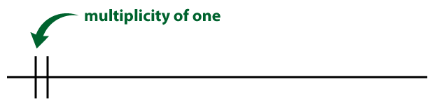

Cardinality/Multiplicity
Multiplicity refers to the maximum number of times that an instance of one entity can be associated with instances in the related entity. It can be one or many.

Slide 47
Relationships
Relationships illustrate the association between two entities. They are presented as a straight line.
Usually, each relationship has a name, expressed as a verb, written on the relationship line. This describes what kind of relationship connects the objects.

Slide 48
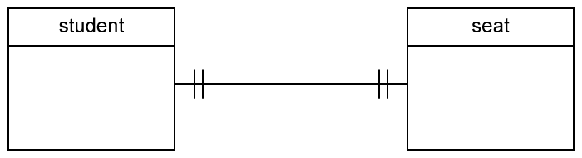
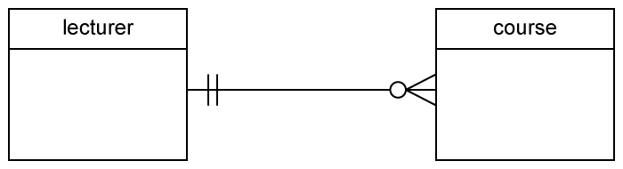
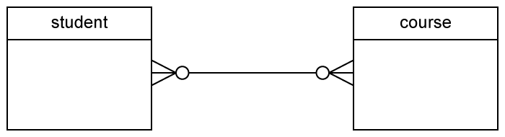
One-to-one
One-to-many
Many-to-many

Slide 49
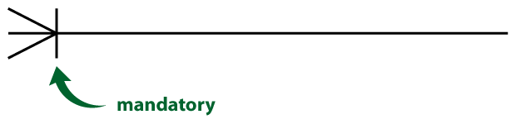

Cardinality/Multiplicity
The minimum number of times one instance can be related to others. It can be zero or one, and accordingly describes the relationship as optional or mandatory.

Slide 50
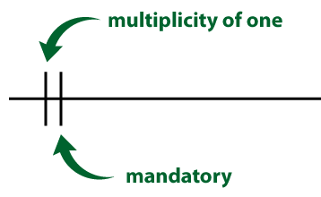
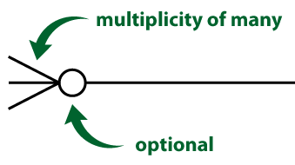
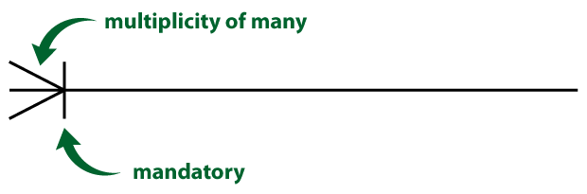
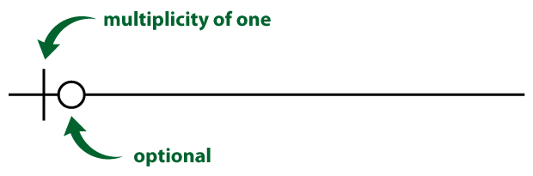
Four possible relationship cardinalities
1. zero or many
3. one and only one
2. one or many
4. zero or one

Slide 51
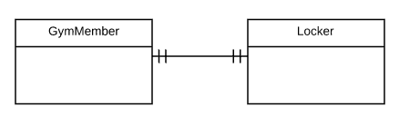
Example
A gym member has one and only one locker.

Slide 52
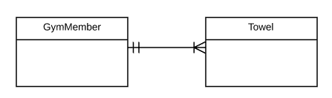
Example
A gym member can have one or many towels.

Slide 53
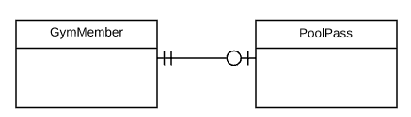
Example
A gym member can have zero or one pool pass.

Slide 54
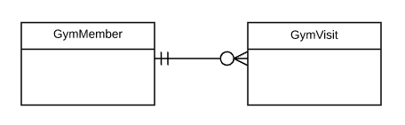
Example
A gym member can have zero or many gym visits.

Slide 55
Example of Other Notation
UML Class Diagrams

Slide 56
UML Class Diagrams
UML methodology
Used extensively in software design
Many types of diagrams for various software design purposes
UML class diagrams
Entity in ER corresponds to an object in UML

Slide 57
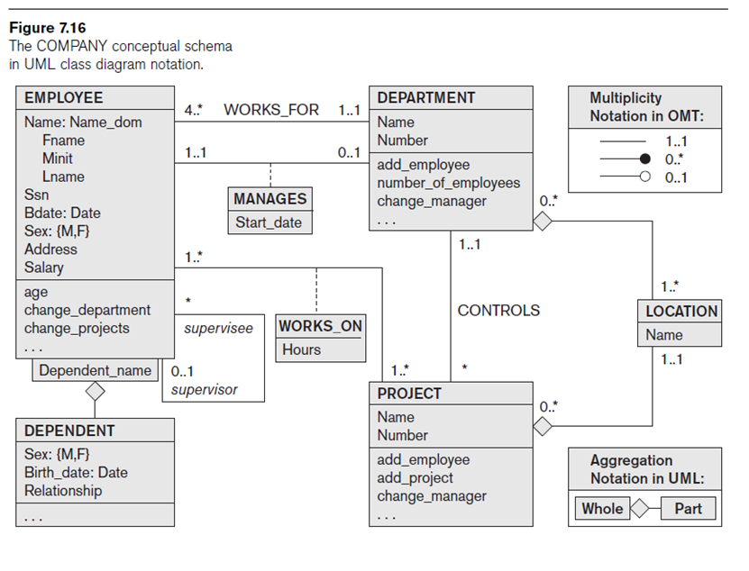
Example
UML Class Diagram

Slide 58

Thank you.
Discuss 3 important things / concepts we have learned today.

